Slide 1
UB LIS 575 Soergel Lecture 02.0 Research supporting practice 0. Introduction
Dagobert Soergel
Department of Information Science Graduate School of Education University at Buffalo
3 min.
75 min. Includes audio for some slides.

Slide 2
Outline of Lecture 02.0
Title | Slides | Time
Introduction 1. Exercise caution and judgment. Critical mindset | 3 - 5 | 16 min
Introduction 2. The role of research in supporting practice | 6 - 12 | 30 min
Systems analysis. Project planning and evaluation. Logic models | 13 - 20 | 15 min
Preview. Research Support for Practice. Part 1. Action Research | 22 | 4 min
Preview. Research Support for Practice. Part 2. Assessment | 23 - 24 | 6 min
 | Total | 75 min

Slide 3
Introduction 1 Exercise caution and judgment Approach with a critical mindset

Slide 4
Look behind the bold claims
One often hears the terms
evidence-based practice
data-driven decision making
or variations thereof uttered with great conviction. But
How good, how certain is the evidence?
Does the evidence apply to the current case or situation?
Is the solution suggested by the evidence feasible? Does it attract enough support among stakeholders? Whose interests does it serve? How powerful are these interests? What ethical issues are involved? Weighing values. Risk assessment
The answers require insight and judgment, negotiation and compromise
This is not simple
10 min.

Slide 5
The role of evidence in practice
Evidence-based practice and Data-driven decision making express the same basic idea, but data-driven implies a narrow kind of evidence and practice is more than decision making, so Evidence-based practice is the broader term
The issues raised on the previous slide lead to a compelling conclusion:
Decisions and, more broadly, practice should be driven
not by data
but by reason and judgment informed by data and broader evidence
Therefore, I will use the term Evidence-supported practice
The term Evidence-informed practice is also used
4 min.

Slide 6
Introduction 2 The role of research in supporting practice

Slide 7
Steps in addressing problems in practice Research support in each step
See next slide
I will use the term case very generally to refer to any of the following:
Problem, project, program, system, action, policy, organization, person...

Slide 8
Case-specific research (idiographic) is research carried out specifically for a case or project in practice with no claim of having value beyond the case (but such value is not excluded)
General research (nomothetic) is research carried out with the idea of contributing to a general knowledge base that can be helpful for many cases or projects in practice in many contexts. However, the scope of applicability must be determined for each "nugget" of knowledge.
Context assessment deals with internal and external factors that influence or affect the outcome variables. These factors may or may not be under the control of the system designers / operators.
Outcome assessment deals with the variables we want to change to a goal level or to maintain at the present (desirable) level.
The following slides show four cases, each with example variables for context assessment and outcome assessment
Start
Assessment
Context
assessment
Outcome
assessment
Also baseline
Case-specific research
Comparison
Before - after Across cases
Make decision
Design or improve system
May involve complex processes
Knowledge base resulting from general research
Implement changes
Monitor / assess implementation
Case-specific research
Audio one 7 min.
Audio two 8 min.

Slide 9
Case | Assessment ꟷ Example variables
 | Context | Outcomes
Health Information campaign in underserved community | Demographics income situation insurance eligibility access to prevention and treatment services access to healthy food walkability | Knowledge of: prevalent health conditions healthy behavior health insurance options services available Incidence of / coverage diseases and other health conditions obesity smoking drug abuse mental health health insurance coverage use of services hunger performance of students in school

Slide 10
Case | Assessment ꟷ Example variables
 | Context | Outcomes
Student academic performance in a classroom | Demographics teacher characteristics student characteristics (other than academic performance), including, for example pays attention in class does homework subscores and score for each ability test, such as IQ student-teacher relationship classroom/school climate, bullying abuse curriculum | The following is real assessment as opposed to using only standardized tests ,which creates the illusion of assessment Assess first each individual student, then do analyses, including averages and aggregates for various subgroups as appropriate. Most data needed are available in student files. For each subject a sub-score for each learning objective the total score standardized test score (if available for the subject teacher narrative student narrative Use multiple measures for each learning objective Take account of measures that might introduce bias against underserved minorities Use before-after difference as measure

Slide 11
Case | Assessment ꟷ Example variables
 | Context | Outcomes
Treating a patient for high blood pressure | Patient medical history Patient other conditions (which constrain medications) Patient conditions that might cause or contribute to high blood pressure Insurance eligibility of medical treatments Patient environment with respect to access to healthy food Patient environment with respect to opportunity for exercise Patient compliance with doctor's orders Patient diet Patient exercise regimen Note: Since diet and exercise are likely part of a treatment plan, they could also be listed under Outcomes The same argument can be made for Patient conditions that might cause or contribute to high blood pressure | Blood pressure readings

Slide 12
Case | Assessment ꟷ Example variables
 | Context | Outcomes
Conviction and sentencing of a defendant in a criminal trial | Defendant's character and prior criminal history (if any) Defendant's family history, e.g., growing up in a dysfunctional family, being abused as a child, etc. Defendant's motivation, e.g. needing money for drugs or food to keep from starving defendant's mental health defendant's state of sanity at the time of the crime. Other extenuating circumstances | The exact process of the crime Objects used in that process Any evidence that ties the defendant to the crime (such as genetic testing of hair or blood) Any evidence that separates the defendant from the crime, such as an (alleged) alibi Degree of premeditation Note 1. Outcomes is used here generally to include any evidence needed to assess whether the defendant committed the crime. Note 2. This evidence must be collected and presented so as to allow matching it with conditions specified in the law. Note 3. Collecting some of this evidence requires precise investigative / historical method, other evidence requires natural science methods, such as ballistics and forensic medicine.

Slide 13
Systems analysis Project planning and evaluation Logic models

Slide 14
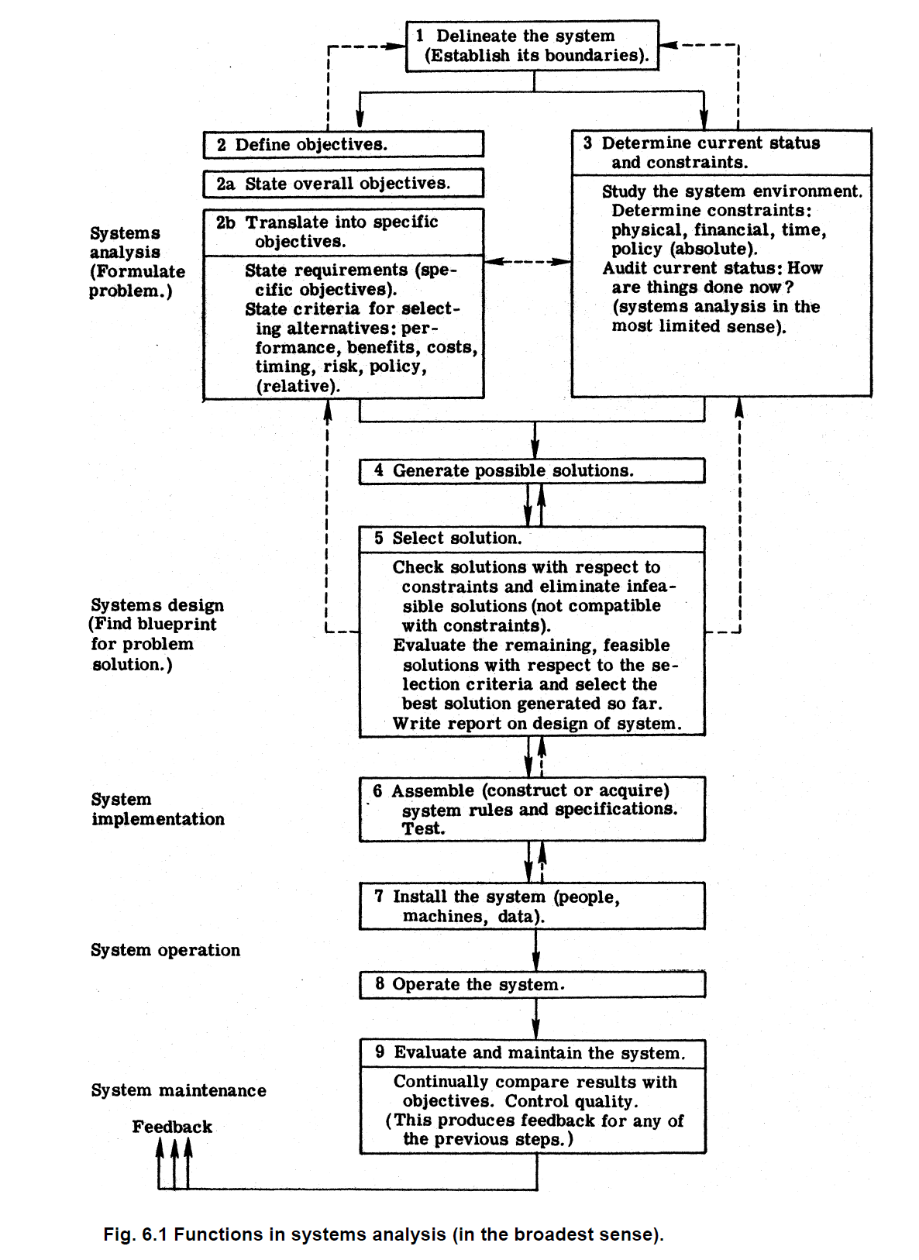
Systems analysis
The Research Support for Practice diagram on Slide 8 is a special case of a general systems analysis diagram such as the diagram on the right, to give one example.
Just read through the diagram; it should be self-explanatory. Not a key point of this lecture. If interested, look at Chapter 6 of the book.
This diagram is from Soergel, Organizing Information You can download a pdf of the book at
http://www.dsoergel.com/UBLIS571DS-00.0-7SoergelOrganizingInformation1985All_Clickable_ContentsDSEdits.pdf
http://www.dsoergel.com/UBLIS571DS-00.0-7SoergelOrganizingInformation1985EndBibliographyAndIndex.pdf
http://www.dsoergel.com/UBLIS571DS-00.0-7SoergelOrganizingInformation1985PrefatoryMatter.pdf

Slide 15
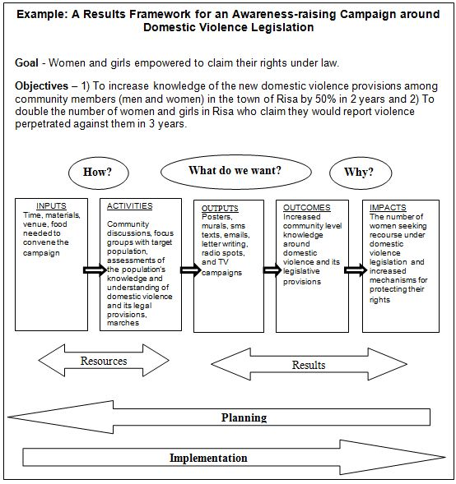
2 min.
Logic models for program planning and evaluation
www.endvawnow.org/
Just a teaser so you know when to learn more.
A logic model provides a systematic framework for applying and using research in practice.
It specifies a program's or system's inputs, activities, outputs, and outcomes+impacts, usually in a graphical representation, such as the one at right. The following slides show some examples illustrating variations in format and content.
At this level, a logic model does not show
which inputs and activities produce what outputs,
which outputs produce what short-term outcomes,
which short-term outcomes produce what medium- or long-term outcomes or impacts.
These relationships are many-to-many, not possible to show on one page.
Specifying all these relationship yields a theory of how the system works (or should work).
o

Slide 16
Layout of a General Logic Model
hhhttps://www.cdc.gov/dhdsp/docs/logic_model.pdf
www.endvawnow.org/

Slide 17
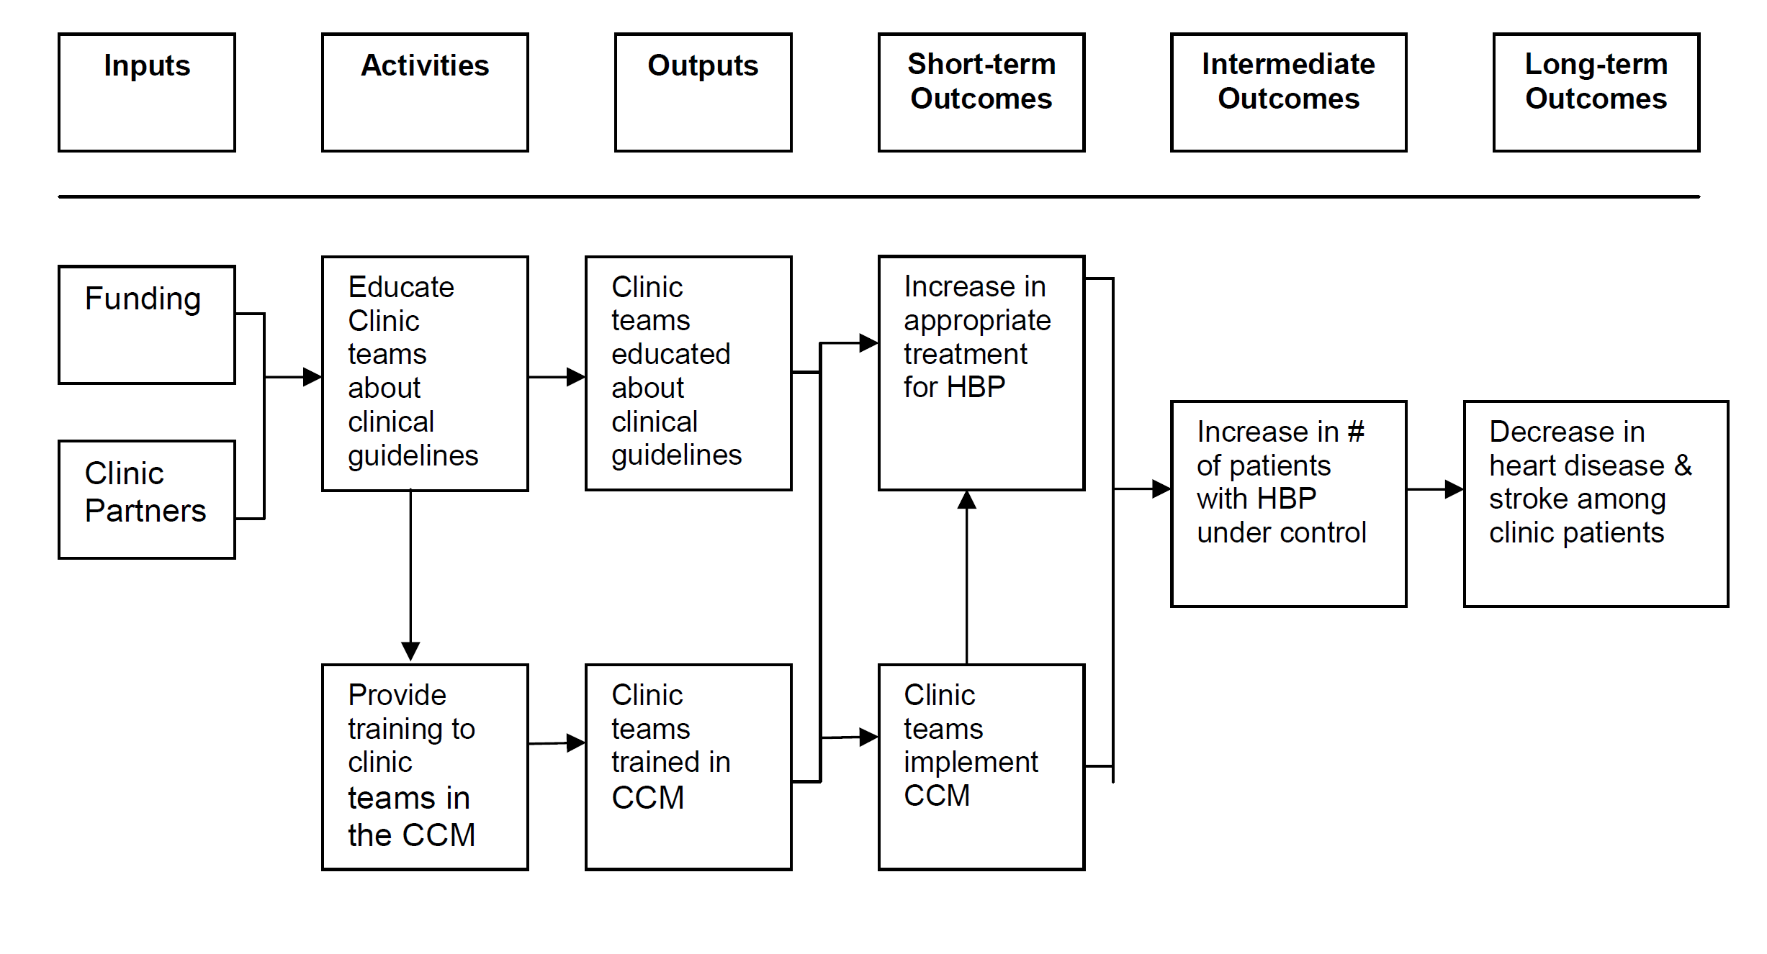
A logic model for a program to reduce the incidence of high blood pressure (HBP) in a community
https://www.cdc.gov/dhdsp/docs/logic_model.pdf

Slide 18
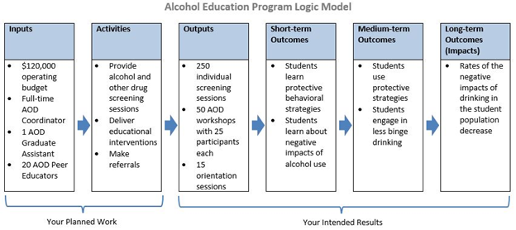
http://studentaffairsassessment.org/entries/blog/logic-models

Slide 20
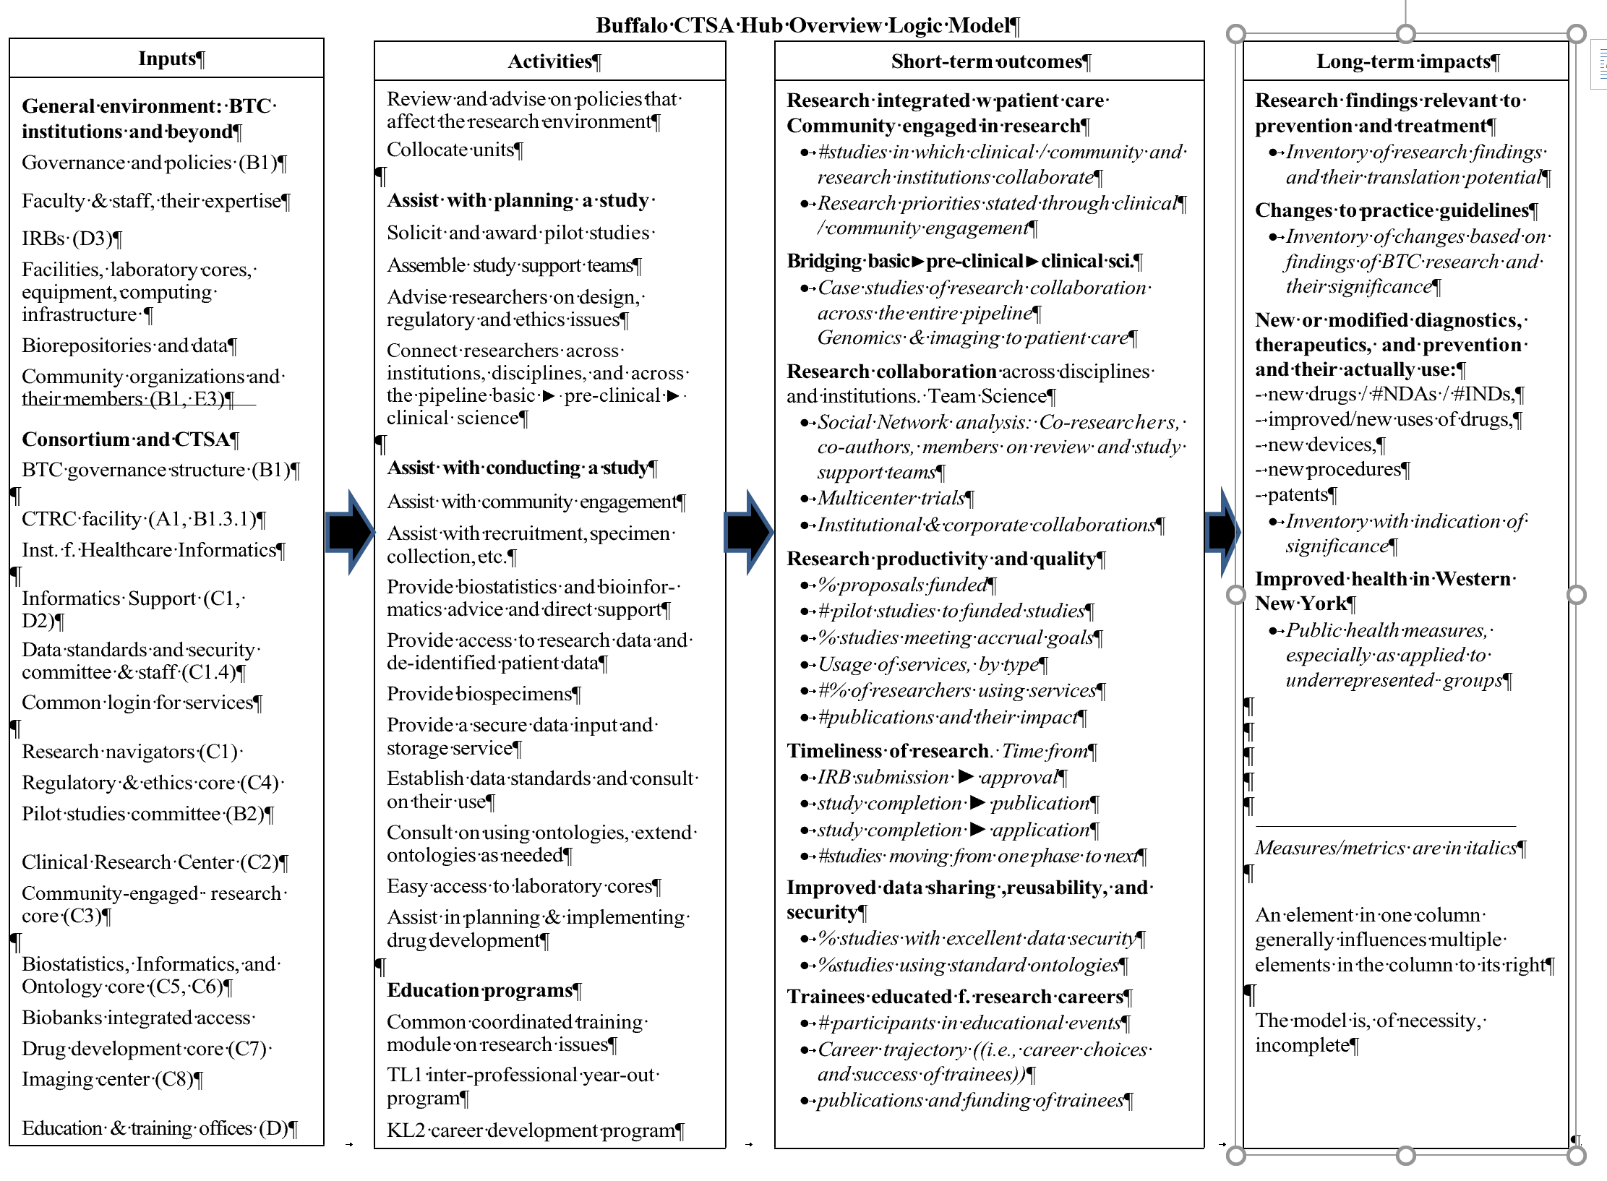

Slide 21
Preview Research Support for Practice Part 1. Action Research Part 2. Assessment

Slide 22
Part 1. Action research
Research accompanying or integrated with a practical undertaking
Often focusing on social or organizational change
Action research is participatory. The research team works with actors, often includes actors, and sometimes consists entirely of the actors.
Action research goes through the entire cyclical process shown on Slide 8. Recurring assessment is an important part of action research.
Could be very small, such as a reference librarian collecting data about user questions and whether the answer was useful (may require follow-up, a good practice anyway). Use what is known about types of questions, how to assess difficulty of questions, etc.). Analyze to see how reference service could be improved.
Could be large, such as a project for improving health in an underserved community involving the health department, the public library, the closest medical school, and community members.
2 min Note: this is not the end of the lecture.

Slide 23
Part 2. Assessment
Assessment is ubiquitous
Often conducted as the only research step
Assessors may not be the ones using assessment results
Typical examples
Quality control (industrial production, reference transactions in libraries, cataloging, quality of care in a hospital)
Number of cases in an epidemic followed over time
Student performance in K-12 standardized testing (often poorly executed, the death of meaningful education)
Job performance
In medicine: Assessment of an individual patient
Issues on next slide
3 min.

Slide 24
Part 2. Assessment continued
Issues
Are the variables used as outcome measures appropriate?
Are the measurements taken accurate?
Related lectures
Lecture 04.2 Research and the complexities of reality Simplistic assessment may lead to entirely wrong conclusions and subsequent actions.
Lecture 05.1 Variables and measurement Choosing the appropriate variables for assessment is extremely important Methods of measurement drawn from the knowledge base of research methods. Scales, such as IQ, or Reading fluency, or student social competency. Medical tests and imaging.

Slide 25
The end

