Slide 1
UB LIS 575 Soergel Lecture 02.1 Research Supporting Practice Part 1. 1a2.2 Action Research
Dagobert Soergel
Department of Information Science Graduate School of Education University at Buffalo
Required 32 min, optional 35 min
1 min

Slide 2
Outline of Lecture 02.1
Title | Slides | Time
Learning objectives | 3 | 2 min
Action research. How to. Required | 5 - 19 | 35 min
What is action research? | 6 - 8 | 8 min
The action research process | 9 - 19 | 24 min
The reflective practitioner | 20 | 3 min
Action research. Theoretical / philosophical background Optional | 21 - 28 | 35 min
 | Total
Soergel, UBLIS575DS-02.2$2-ResearchSupportingPracticePart2ActionResearch.pptx

Slide 3
Learning objectives
Students are expected to
Understand the nature of action research
Understand the potential of action research to help improve local conditions
Be able to discern situations where action research would be helpful
Be able to educate themselves so they can conduct or assist in action research

Slide 4
Action research. How to Required

Slide 5
What is Action research?
1a2.2 Action research is research that
is motivated by the desire to improve some situation to help people, prototypically people from some underrepresented group or people treated poorly, in the pursuit of equity, fair and accepting treatment of all, and social justice;
aims at making action more effective, accompanying action and constantly monitoring results to find ways for achieving better results ꟷ action research is closely intertwined with action;
is carried out by a team that prototypically consists of or includes the actors (activists) and representatives of the community whose life is to be improved, and possibly external researchers.

Slide 6
Where can Action Research be used?
Action research can be conducted in many contexts:
issues, such as climate change, from local to global;
society at large (neighborhoods, government jurisdictions at all levels, from city/county to province to entire nations;
schools, from classroom to building level to entire system; K - 12 to higher education
libraries, again at many levels
other organizations, companies, non-profits, government agencies
The purposes listed on the next slide apply across these contexts.

Slide 7
Action research by focus / purpose
Teacher, librarian, human resource manager, community organizer, ... ꟷ the person doing the research learning about themselves in their job role
Students, library patrons, employees, community members ꟷ the people whose situation is to be improved (and who may participate in the action research project). Organizational/school climate (e.g., bullying)
Curriculum, collection development priorities, position descriptions ꟷ content guidelines for work
The "system" ꟷ policies governing teacher's/librarians'/etc. work, resource allocation and planning, equity
May be more
Further question: who is going to implement the actions suggested by action research results, the researchers (as is typical) or a third party.
You may want to look at the Deliverable 1 Guide before proceeding.
4 min

Slide 8
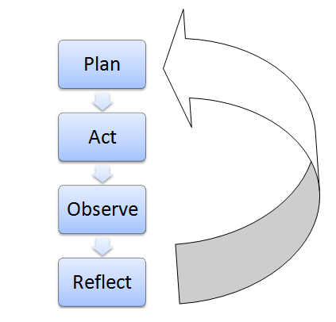
The action research cycle
https://research-methodology.net/research-methods/action-research/
Editorial note: I rearranged the sequence of this lecture, so references to part of lecture or slide # in the audio do not apply
2 min Ignore the "third and last part"

Slide 9
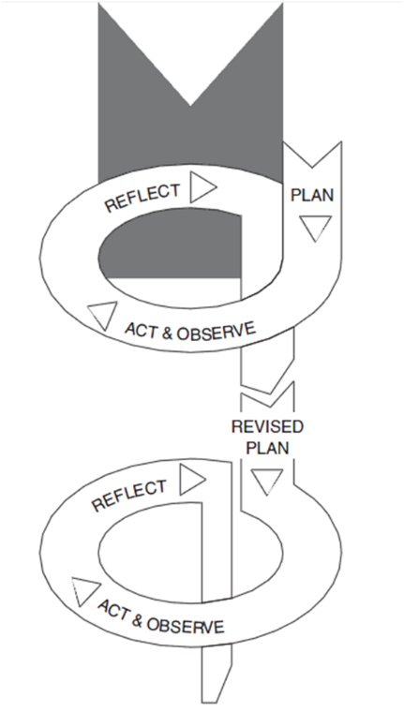
The action research cycle (or spiral)
https://research-methodology.net/research-methods/ action-research/ citing Kemmis and McTaggart (2000)
1 min

Slide 10
The action research process Detailed steps
Note on lack of attribution
Compiled from many sources, but no attribution even if pieces of text are included verbatim.
If this was a publication, I would have to go to the work to trace the sources. I have a document with the individual models and their sources.

Slide 11
Plan
Diagnosis where the problematic situation is studied. Then a plan is developed
Identify a problem
Research the problem and its probable causes.
Collect data.
Organize data
Analyze and interpret data
Develop an action plan
Many of the following slides have detailed text that you can just read without audio. .
2 min Ignore "The last part" and the slide number mentioned

Slide 12
Plan
Identify a problem
Identify an area (general focus) of interest. Example: As a teacher: recognize and wonder about a problem in the classroom. May itself be based on using/analyzing data (existing or specifically collected). Look at both immediate and long-term effects to be achieved.
Think about possible reasons students are having trouble.
Inform your thinking about the problem through indirect research. Pay attention to probable causes. Identify professional literature that relates to the problem. Gather research reports, research syntheses, articles, websites, reports on similar projects, videotapes, etc. Analyze and interpret these materials for understanding and possible actions. Note: This happens at many steps in the process.
Narrow your focus. Define the specific problem.

Slide 13
Plan, continued
Research the problem and its probable causes.
Collect data. Collect existing archival data. Use additional multiple data sources. Many methods: interviews, focus groups, observations, questionnaires etc. Collect data regularly. Monitor data collection. Promote collective ownership of data.
Organize data Count instances, events, and artifacts. Display data in tables and charts. Example: Arrange data by classroom, grade level, and school. Organize for analysis.
Analyze and interpret data Analyze and question the data (may be done by an individual or as a professional collective . Decide what can be celebrated and what needs attention. Determine priority area(s) for action.

Slide 14
Plan, continued
Develop an action plan (response to the problem, addressing the problem).
Come up with solutions to try.
Consider short-term and long-term actions.
Analyze alternative actions and determine the most promising actions.
Develop an action plan with milestones for short-term and long-term actions. Consider feasibility/resources

Slide 15
Act
Implement the action plan.
Implementation may be in phases, in which case Observe and Reflect happen at the end of each phase. In general, Observe and Reflect happen continuously as the action unfolds
1 min

Slide 16
Observe
Evaluate the results of the actions taken.
Assess the realized interventions using qualitative and/or quantitative techniques.
1 min

Slide 17
Reflect
Reflect on the results.
Learn: generate findings and knowledge.
Report results.
Put differently Sharing: critical reflection and communication of learning: Reflection upon the experience, which may bring the realization of further actions
Action research results may be applicable in other places with similar characteristics
2.5 min

Slide 18
Repeat
Observation (assessment) and Reflection lead to the identification of one or more new problems.
The cycle of continuous improvement starts over.
Observation and Reflection take on the role of Problem identification and Researching the problem and its probable causes in the next iteration
1 min Ignore "This is the end of the lecture"

Slide 19
Another view of the action research process
Sometimes it is useful to go over the same material from a different perspective.
The Word document is the most useful part of what used to be a separate reading. After you looked at that and at the next slide would be a good time to read
\Box\575DS\Week02\UBLIS575DS-02.2$3-Deliverable1AssessmentAndActionResearchProposalGuide.docx
and start working on Deliverable 1 by jotting down some thoughts in the templates in
\Box\575DS\Week02\UBLIS575DS-02.2$3-Deliverable1AssessmentAndActionResearchProposal.docx
4 pages

Slide 20
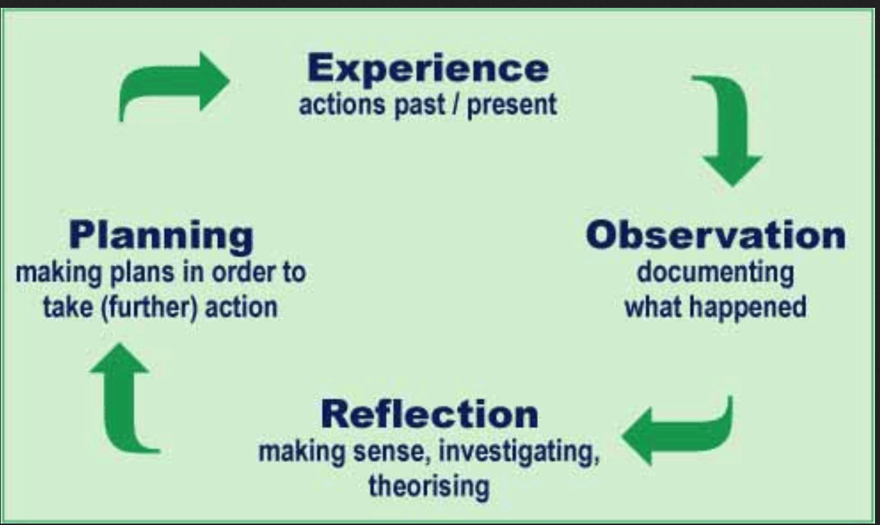
The reflective practitioner
An idea closely linked to action research. A stance all of you should aspire to.
Resources
Reflective Practitioner. Growth is an ongoing responsibility Applicable well beyond education https://www.edutopia.org/blog/master-teaching-margaret-regan
https://en.wikipedia.org/wiki/Reflective_practice
Picture from https://imbringingsexyblog.wordpress.com/2011/05/20/being-a-reflective-practitioner/
1.5 min

Slide 21
Action research. Theoretical / philosophical background Optional

Slide 22
What is action research? A review of definitions
Many definitions, often adapted to a specific domain See the embedded 13-page Word document
General, society, community, social justice
Education (the bulk of recent literature deals with the education domain, but many insights can be transferred)
Organizations, business
13 pages, not needed to understand the remaining slides
2 min

Slide 23
What is action research Closely related approaches
1a2.1 Scientific research integrated with product development Research questions emerging from specific problems encountered by the engineers working on the development of a product. Research and Development (R&D) Can also be applied to developing procedures or policies or behind-the-scenes software, such a operating systems
1a2.1.1 Participatory design Working closely with potential users on the design of products, systems, user interfaces, etc. Participants can be children.
3 min

Slide 24
Types of action research
Action research by philosophical orientation
Action research by the degree to which an outside researcher influences the action research project
Action research by scope
Action research by focus
1 min

Slide 25
Action research by philosophical orientation
Positivist or empirical - analytical approach to action research, also known as ‘classical action research’ perceives research as a social experiment. Accordingly, action research is accepted as a method to test hypotheses in a real world environment. Interpretive-hermeneutic action research, also known as ‘contemporary action research’ perceives business reality as socially constructed and focuses on specifications of local and organisational factors when conducting the action research. Emancipatory - critical action research adopts critical approach towards business processes and aims for improvements.
https://research-methodology.net/research-methods/action-research/, modified
Addendum
Interpretive-hermeneutic approach to the teaching fractions problem
Observe students' expressions and engagement during the class period. Informal interviews after how students feel about the lesson and their attitudes to fractions.
Elicit students' thought processes as they learn and as they solve division-by-fraction problems afterwards. Can use log of steps students take, think-aloud protocol, even brain scans that tell what brain areas are activated at various steps in the process.
5 min

Slide 26
Elaboration for those specially interested in this topic. No audio
TABLE 1: The emancipatory-critical paradigm.
Paradigm | Empirical-analytical | Interpretative-hermeneutic | Emancipatory-critical
Relationship of researcher to ‘reality’ | Testing and measuring | Exploring and interpreting | Changing and transforming
View of the researched person | Object to be measured | Subject to be understood | Participant in the process
View of truth | Correspondence to the facts | Coherence within the data | Consensus of each person’s learning
Research process | Predominantly quantitative measurements | Predominantly qualitative measurements | Participatory using both quantitative and qualitative techniques
Research question | Fixed hypothesis Set by the researcher | Open-ended question Set by the researcher | Open-ended question Negotiated with group and can evolve
Implementation of results | Recommendations made for action by other people Generalizable | Insights offered for use by other people Transferable | Findings implemented as part of the research Transferable

Slide 27
Action research by the degree to which an outside researcher influences the action research project in terms of framing the research question and determining the direction the research will take (high to none)
1 | Technical Action Research The practitioner, though a collaborator in the research, is not the main researcher. The main researcher identifies the action research problem and proposes an intervention. The practitioner is involved in the implementation of any interventions.
2 | Practical Action Research Here the researcher and the practitioner identify the research problem together and discuss underlying causes and possible interventions.
3 | Emancipatory Action Research Practitioners work together as a group and collectively identify problems and possible solutions. Solutions are as much political and consciousness raising as practical. There is a strong social element here as well, in that it is expected that participants will emerge with a new view or theory of society.
http://cei.ust.hk/teaching-resources/action-research/models-and-examples
1 min

Slide 28
Action research by scope
 | Individual teacher Classroom level | Collaborative Classroom level+ | School-wide Building level | District-wide District level
Focus | Single classroom issue | Single classroom or several classrooms with common issue | School issue, problem, or area of collective interest | District issue Organizational structures
Possible support needed | Coach/mentor Access to technology Assistance with data organization and analysis | Substitute teachers Release time Close link with administrators | School commitment Leadership Communication External partners | District commitment Facilitator Recorder Communication External partners
Potential impact | Curriculum Instruction Assessment | Curriculum Instruction Assessment Policy | Potential to impact school restructuring and change Policy Parent involvement Evaluation of programs | Allocation of resources Professional development activities Organizational structures Policy
Side effects | Practice informed by data Information not always shared | Improved collegiality Formation of partnerships | Improved collegiality, collaboration, and communication Team building Disagreements on process | Improved collegiality, collaboration, and communication Team building Disagreements on process Shared vision
3 min

Slide 29
The end

