Slide 1
UB LIS 575 Soergel Lecture 04.2 Research and the complexities of reality A cautionary tale from the field of education
Dagobert Soergel
Department of Information Science Graduate School of Education University at Buffalo
90 min, includes audio and embedded .docx
5 min

Slide 2
Outline of Lecture 04.2 | Slides | Time
Title slide. Outline. Learning objectives | 1-3 | 10 m
Introductory example | 4 | 10 m
Many independent variables that interact Importance of theory and causal diagrams. individual differences. Situation dependence | 5 | 7 m
Example 2. Studying the effects of online instruction | 6 | 8 m
One more caveat: General method vs. implementation | 7 | 10 m
Precision data analysis for precision services | 8 | 2 m
Measuring variables. Pitfalls of individual differences | 9 | 4 m
Outcome measures
by unit of analysis: Individual student, Individual teacher, classroom, school ꟷ building level, school district, learning material | 10 | 3 m
Issues: Desirable outcomes that are hard or impossible to measure Inappropriate ways to measure. Sleeper effects. Unintended outcomes | 11 | 6 m
Purposes: Assess student for future education path or job credential Assess quality of instruction. Need to measure student progress against odds | 12 | 10 m
Precision education | 13-15 | 10 m
Conclusions | 16-18 | 10 m
 | Total | 90 m
Soergel, UBLIS575DS-04.2$2-Lecture04.2ResearchComplexitiesReality.pptx
2

Slide 3
Learning objectives
Just read
Beware the simpletons
Students should understand and apply in their actions the following:
Reality is complex.
Findings from research that does not consider this complexity are often misleading and may "support" poor decisions.
When applying research findings or research-based guidelines to decisions, always consider the special circumstances.
The question is never What is best? but What is best for whom for what purpose in what circumstances?
Computer systems enable precision education and precision library service.

Slide 4
Introductory example
Just read
From
Joyce, B. R., & Joyce, E. A. (1970).
The creation of information systems for children.
Interchange, 1(2), 1-12.
Design question: In a system that lets children search for slides depicting activities and objects from a different culture they study, should we use
a detailed classification (or category system), resulting in specific answer sets for specific questions or
a broad classification, resulting in a broad answer set even if the question is specific?
Which is more conducive to learning?
Answer: It depends on the user
Read the summary in the Word document
2 p.
4
Soergel, UBLIS575DS-04.2$2-Lecture03.2ResearchComplexitiesReality.pptx

Slide 5
Many independent variables that interact
Education outcomes depend on many independent variables. Importance of theory and causal diagrams. individual differences. Situation dependence
These variables interact. In many studies the researcher works to mask the influence of variables not of chief interest by randomizing so that over the whole sample the effect of such variables is canceled out. This technique cannot be used when there are significant interactions among variables.
Many of these variables are for the individual student. Collecting just classroom-level aggregate values hides the effects of such variables. Get assessment results for individual students for precise data analysis.
To get a sense of the many variables, have look at the attached Word document. You do not need to read the document word-by-word. Look at the diagrams (p. 1 - 3) somewhat carefully Skim Table 1 (p. 4 - 6) Optional: Skim the material on p. 7 - 11 Included just for reference: Table C, p. 12 - 18
7 min
18 p. total

Slide 6
Example 2. The effects of online instruction
There are many interacting variables this depends on
Student characteristics, including
Student ability in the subject area
Student ability working with computers
Student's dependence on social interaction
The subject area and the specific concept or skill to be learned
The intellectual quality of instruction and support for learning
The usability of the learning platform / user interface provided
The ability of the teacher in preparing or selecting online lessons and other learning activities
The quality of the online lessons and other learning activities
The degree to which material provided to students is personalized
The quality of support for online meetings and collaboration (full class or group meetings)
How individual learning is monitored
Hardware support for students
The quality of the student's computer (0 if the student has no computer)
Bandwidth of the student's Internet access (0 if no Internet access)
7 min

Slide 7
One more caveat General method vs. implementation
We want to study the effect of a general method, approach, or design principle
What we actually test is the effect of a particular implementation
If the implementation is poor, conclusions about the general method are faulty. The devil is in the detail.
Examples
1 Principle: Examples first, Rules afterwards or the reverse Application: Teaching reading Whole words first, Phonics afterwards or the reverse
2 Broad classification vs detailed classification
3 Hypothesis With a teacher or librarian of their own race/ethnicity, students get more engaged
10 min

Slide 8
Precision data analysis for precision services
Just read
School psychology research and practice has considerable room for growth to go beyond
"did an intervention work?" to "what intervention worked for whom and how did it work?"
The latter question reflects a more precise understanding of intervention, and involves strategic efforts to enhance the precision of services to [all students, in particular] students with academic, behavioral, emotional, or physical health problems to enhance the degree to which interventions are appropriately tailored to and produce benefit for individual students.
From the abstract of Clayton R. Cooka'*, Stephen P. Kilgus, Matthew K. Burns 2018 Advancing the science and practice of precision education to enhance student outcomes Journal of School Psychology 66 (2018) 4-10

Slide 9
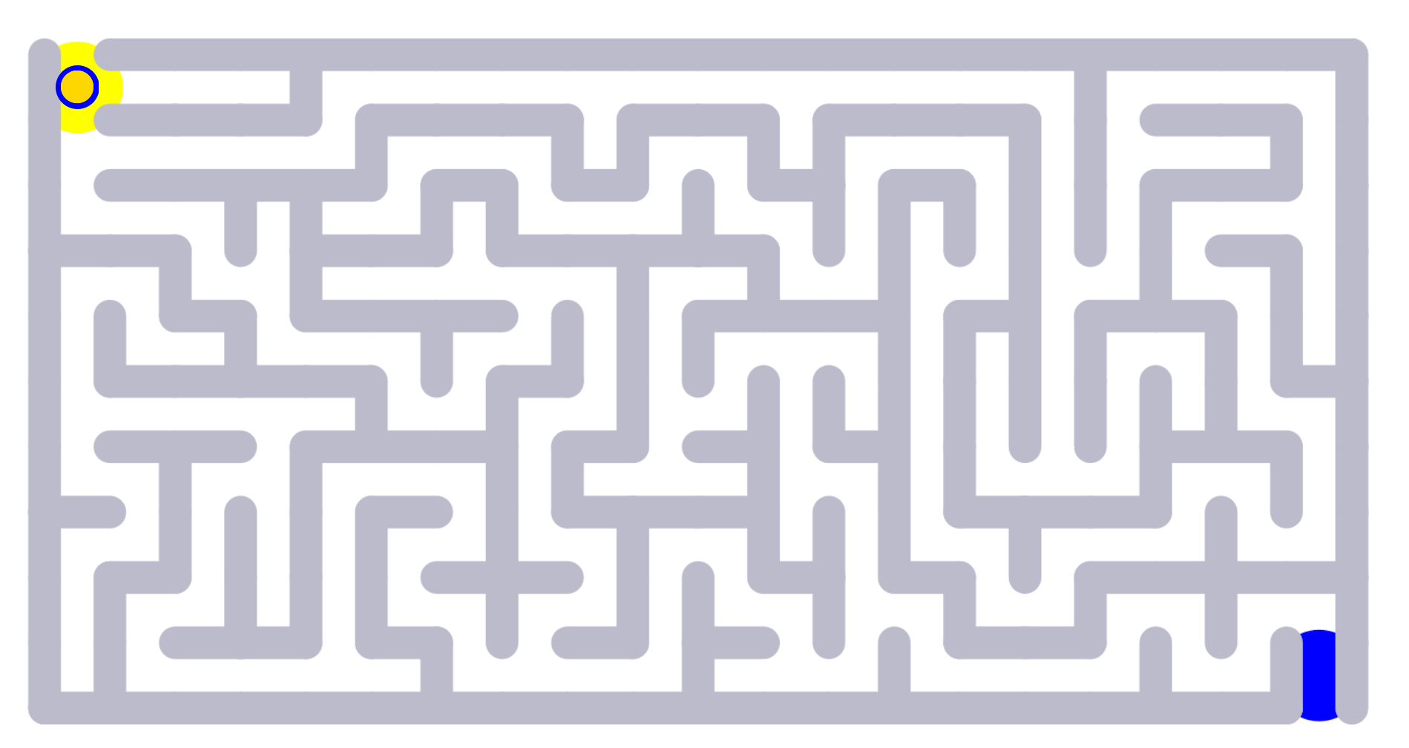
Measuring variables. Pitfalls of individual differences
The maze game and The boy who loved sounds
4 min
9
Soergel, UBLIS575DS-04.2$2-Lecture04.2ResearchComplexitiesReality.pptx

Slide 10
Outcome measures
Just read
By unit of analysis:
Individual student
Individual teacher
Classroom
School ꟷ building level
School district
Learning materials
Outcome measures for levels above the student serve to assess the quality of that level, such as teacher performance. Most such measures are derived by aggregating the outcome measures of the individual students involved.
For good results, one must use precision measurements of a student's progress. As the following slides show, this is a far cry from using standardized tests.

Slide 11
Outcome measures. Issues
Desirable outcomes that are hard or impossible to measure. For example
Thinking and problem-solving skills
Understanding other cultures and overcoming prejudice
For such outcomes we can say (I will give the source on Slack): "What can be counted does not count, and what counts cannot be counted."
Inappropriate ways to measure
Tests are not always the best way to measure student's understanding. Having a student give a presentation may be a better window into the student's mind.
Long-term effects (sleeper effects)
I met a student three years after he completed my course in knowledge organization. He told me "I just took a new job where I need to organize learning materials to support personalized instruction. Now I finally understand what you have been teaching us about 'request-oriented indexing'."
Unintended outcomes (good or bad). For example
Mental health issues of children due to isolation with online-only education Note: With better support for online social interaction this could be alleviated.
5 min

Slide 12
Outcome measures. Purpose
Purpose 1. Assess a student's present knowledge, skills, and abilities for purposes of
determining the student's further educational path, including promotion to next grade and college admission
providing a credential potential employers can use to assess job applicants
To be fair, this requires appropriate assessment methods and precision measurement.
Purpose 2. Assess quality of instruction and the learning environment. Evaluate teachers This requires
measuring each individual student's progress over a time period, such as a school year
comparing the progress predicted from student characteristics vs. progress achieved
Progress of a student, particularly progress against odds, rather than present knowledge that depends on many external factors, is the true measure of the quality of instruction. Progress can be measured only for individual students. The quality of instruction can then be determined by analyzing progress scores.
Evaluating teachers by averaging standardized results is moronic.
6 min

Slide 13
Precision education
Just read
"Precision education assumes that the sciences of genes, neurology, behaviour and psychology can be combined in order to provide insights into learning processes, and to define how learning inputs and materials can be organized in ways best suited to each individual student", 'taking into account a host of factors about the individual, ...'
'Potential benefits of precision education
Early interventions for those at risk of learning disorders
Learning materials tailored to individuals, including high and low ability
Greater choice for the learner who can target areas of weakness or further develop areas of strength depending on their goals'
"..." from https://codeactsineducation.wordpress.com/2018/04/16/personalized-precision-education/
'...' from https://bold.expert/precision-education/

Slide 14
Precision education. Forerunners
Just read
IEP and 504 Plan
Both serve children who have a disability identified under the law and are attending an elementary or secondary educational institution.
An Individualized Educational Plan (IEP) is developed for students with disabilities who do require specialized instruction to ensure that they receive the required specialized instruction and related services.
A 504 Plan is a plan developed for students who do not require specialized instruction but need special accommodations to ensure equal access to public education and services. The Plan outlines their specific accessibility requirements to ensure their academic success and access to the learning environment.
Information from https://www.washington.edu/accesscomputing/what-difference-between-iep-and-504-plan

Slide 15
Precision education. Forerunners
Differentiated instruction
See attached
Just read the Word document
1 p.

Slide 16
Conclusion 1
Just read
Advanced computer systems allow tracking details, for example for individual students, for teachers, for classrooms. Precision!
I have in my ear Precision! to the sound of Tradition! in The Fiddler on the Roof

Slide 17
Conclusion 2
Just read
Precision enables
Precision measurement
Precision data analysis that takes many factors into account, thus capturing much of the complexity of reality, for this lecture: of how people learn
Personalized precision service, for example in education, using
the complete picture of a student's characteristics and the nature of the subject the student wants to or must master
precise evidence on how a student with these characteristics learns a subject with these subject characteristics
knowledge of the prerequisite structure of the subject
to select and sequence learning experiences and materials in ways best suited to each individual student
Precision assessment of students, teachers, methods of learning and instruction, and specific learning materials and software systems

Slide 18
Conclusion 3
Beware the mindless over-simplifiers, such as people who mandate standardized tests and use the results for making (often wrong-headed) decisions without understanding the complexities of education.
6 min
This audio clip was produced when this lecture was at the end of the course, so ignore the very end.

