Slide 1
UB LIS 503 Programming Soergel
Computer Programming as the Art of Thinking
Weekly Welcome. Week 5
Dagobert Soergel
Department of Library and Information Studies
Graduate School of Education
University at Buffalo
Includes video. 3 minutes

Slide 2
What you will learn
What is exciting
Flow of control
Decisions
if condition :
suite of statements
else :
suite of statements
Repetition through loops
while condition :
suite of statements
for X in Y :
suite of statements
Defensive programming
Programming through copying

Slide 3
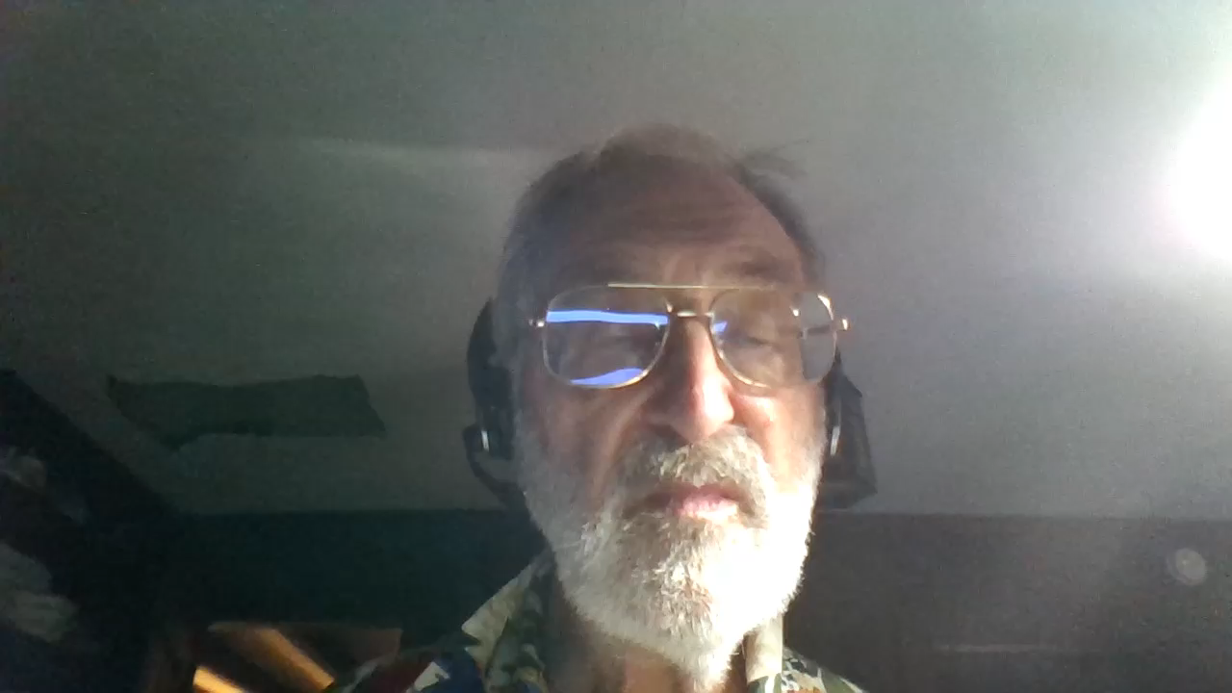
What you will learn
What is exciting

