Slide 1
UB LIS 571 Soergel Lecture 3.1 The structure of information systems
Dagobert Soergel
Department of Library and Information Studies Graduate School of Education University at Buffalo
Includes audio 1 hour, 20 minutes + 20 min optional

Slide 2
How to use these slides repeated
The lecture or exercise is divided into segments listed on Slide 3.
Many slides have audio. To start the audio:
Mouse over the speaker icon.
A familiar play-back control bar appears. Click on ►to start, click on || to pause.
Other slides have just instructions or are just to read or direct you to read something.
If you do not have MS PowerPoint 2010 or later (also available for Mac), get it free from UB IT.

Slide 3
Outline Lecture 3.1
Title | Slides | Time
Introductory exercise. Web Subject Directories | Slide 5
DMOZ / Open Directory | Slides 6 - 8 | 10 minutes
Wikipedia Portals | Slide 9 | 5 minutes
KidsClick | Slide 10 | 5 minutes
Optional: List of subject directories | Slide 11
Analysis of information systems based on the diagram p. 93
General | Slide 12-13 | 25 minutes
Google | Slide 14 | 15 minutes
Wikipedia portals | Slide 15 | 5 minutes
Special library | Slide 16 | 15 minutes
Production and use of a textbook (optional) | Slide 17 | 20 minutes

Slide 4
Lecture 3.1, p. 89 Analysis of Information Systems
Overall outline
Introductory exercise on subject directories on the Web
Analysis of four information systems, using the diagram on p. 89 (This prepares you for Assignment 5)
Google
The Wikipedia directory
A special library
Optional: production and use of a textbook

Slide 5
Lecture 3.1 Introductory exercise Subject Directories on the Web
A subject directory is a collection of Web pages arranged by subject, similar to a library shelf list (the catalog of the library arranged by subject, mirroring the arrangement of the books on the shelves)
General directions
You are going to look at three examples. For each example, you find one or more slides.
The last slide for each directory sets you up for exploration: In slideshow view: Click on the URL to open the directory. In normal view: Right-click on the link, then select Open Hyperlink. Explore the directory. You can press the audio button for a guided exploration.
When done exploring, return to the slides (you can use Alt-Tab) and go to the next slide.
You may want to use a separate tab for each system and keep the tab for Wikipedia Portals open for the second part of the exercise

Slide 6
Lecture 3.1 Introductory exercise Subject Directories on the Web DMOZ / Open Directory
DMOZ (from directory.mozilla.org, its original domain name) is a multilingual open-content directory of ~ 4 million of World Wide Web links. The site and community who maintain it are also known as the Open Directory Project (ODP). It is owned by AOL but constructed and maintained by a community of ~ 90,000 volunteer editors.
DMOZ uses a hierarchical scheme of ~ 1 million categories for organizing site listings. Listings on a similar topic are grouped into categories which can then include smaller categories.
From http://en.wikipedia.org/wiki/DMOZ
Even though this directory can be quite useful, its actual use for searching appears to be limited.
The next slide shows the top page of the directory

Slide 7
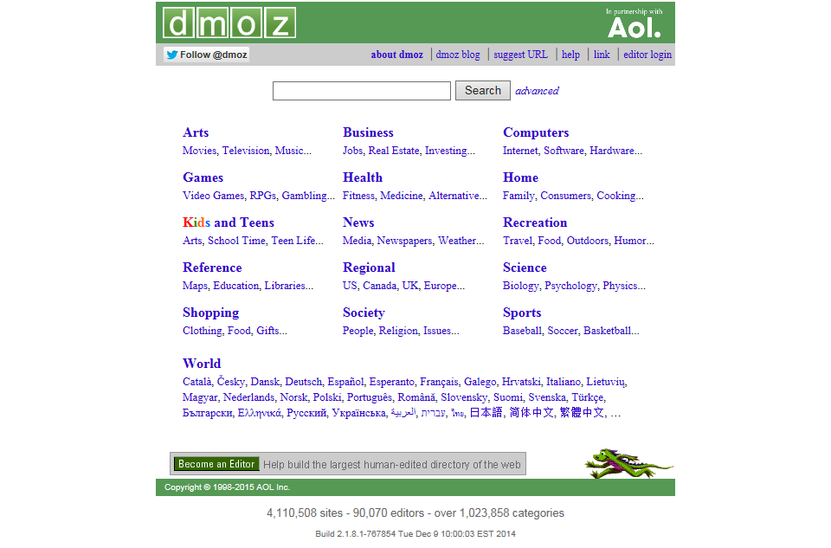

Slide 8
Lecture 3.1 Introductory exercise Subject Directories on the Web DMOZ / Open Directory cont.
Click on http://www.dmoz.org/docs/en/about.html
Explore on your own
Or: Click on the audio icon to start guided exploration
If you want to start and stop the audio while you explore the DMOZ directory, have your browser window and the PowerPoint window side by side or overlapping or use Alt-Tab to switch between them.
Audio 8 min.

Slide 9
Lecture 3.1 Introductory exercise Subject Directories on the Web Wikipedia Portals
A subject directory to the articles in Wikipedia, useful for browsing
The interface needs work
Similar to the more elaborate and elaborated Encyclopedia Britannica Propaedia: An Outline [or Map] of Knowledge First volume of the last print edition, not in the online version.
Explore
https://en.wikipedia.org/wiki/Portal:Contents/Portals

Slide 10
Lecture 3.1 Introductory exercise Subject Directories on the Web KidsClick
A subject directory for children, as found in many library catalogs. Many such directories have a version that uses images to represent subjects.
This site has its problems, but it is useful to illustrate the idea.
When you explore, look at the result list of websites that appears when you click on a category at the bottom of the hierarchy (a "leaf node"). What information is given for each result?
Note: The Dewey Decimal Classification part at the bottom should have terms to show what each class range contains.
http://www.kidsclick.org/

Slide 11
Optional FYI
Subject Directories/Virtual Libraries
From http://hanlib.sou.edu/searchtools/subjdir.html Defunct entries omitted, descriptions edited
About.com Can be searched or you can explore both topics and channels alphabetically.
AcademicInfo Concentrates on authoritative information for academic or higher education uses.
Virtual Reference Shelf A topical list for research from the Library of Congress.
Digital Librarian Well-organized by subject and easy to use.
Best of the Web Sites that are rich in content. Organized by topic and region. Searchable by keyword.
Open Directory Project Simple to search. Organizes the retrieved sites by categories and by individual sites. Try the Advanced Search to refine a search.
World Wide Web Virtual Library The oldest subject directory of the Web, started by Tim Berners-Lee, maintained by individuals around the world who are responsible for the content.
A1WebDirectory.org Organized into general categories with subheadings. Websites listed with short descriptions.
JoeAnt JoeAnt is directory of Web sites chosen by editors and organized into subjects.
http://www.alivedirectory.com/ Added by DS. Interesting
Directory list from the perspective of advertising: http://thesearchenginelist.com/directory.html

Slide 12
Lecture 3.1, p. 89, diagram p. 93 Analysis of Information Systems
Analysis of information systems, using the diagram Lecture Notes p. 93 (facing p. 92).
The audio walks you through the diagram, giving examples.
In the remainder of this lecture you will apply the diagram to the analysis of 3 or 4 information systems, preparing you for Assignment 5.
Audio 25 min.

Slide 13
Lecture 3.1, diagram p. 93 Analysis of Information Systems
Analysis of four information systems, using the diagram on p. 93
Google
The Wikipedia directory
A special library
Production and use of a textbook (optional:
For each information system, proceed in two steps:
Analyze the system on your own (recommended, but adds to the time) Go through the diagram on p. 93 or through the Template for information system description Ass. p. 69 and ask yourself: What is this file in system X? and How is this process done in system X? Perhaps even take some notes.
Listen to the explanation in the audio.

Slide 14
Lecture 3.1, p. 93 Analysis of Information Systems Google
Analyze Google on your own
Listen to the explanation in the audio
Audio 13 min.

Slide 15
Lecture 3.1, p. 93 Analysis of Information Systems Wikipedia Portals
Analyze Wikipedia Portals on your own
Listen to the explanation in the audio
Audio 5 min.

Slide 16
Lecture 3.1, p. 97 Analysis of Information Systems A special library
This analysis is for a generic special library. You can think of your own example. In the audio, I will refer to the library of the Center for Food Safety and Applied Nutrition (formerly the Bureau of Foods), a center in the Food and Drug Administration (FDA)
Analyze a special library on your own
Listen to the explanation in the audio
Audio 15 min.

Slide 17
Lecture 3.1, p. 97 Analysis of Information Systems Production and use of a textbook
Optional
Analyze production and use of a textbook as an information system
Listen to the explanation in the audio
Audio 18 min.
End of Lecture 3.1

